Slide 1

Lecture 1.1: Introduction

Slide 2
Agenda
1
What is Firewall
2
Types of Firewall
3
Firewall in Linux kernel
Notes:
2
2
2

Slide 3
What is Firewall
1
What is Firewall
2
Types of Firewall
3
Firewall in Linux kernel
Notes:
3
3
3

Slide 4

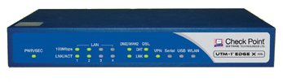
What is Firewall
Primary goal: protect an internal network (or host) from external attacks
Inspects and controls network traffic
Controls the incoming and outgoing network traffic from a network (or host) based on a rule set
A firewall establishes a barrier between a trusted, secure internal network and another network (e.g., the Internet) that is not assumed to be secure and trusted
Can be hardware or software-based, depends on needs

Slide 5
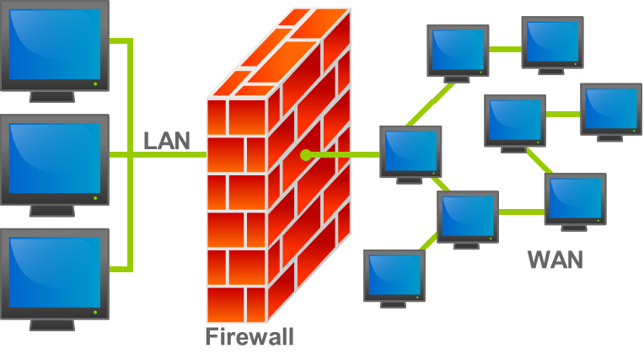
Network topology
All network traffic should go though the firewall to be effective
We need to set up the network topology in such way that all incoming/outgoing traffic will go though the firewall

Slide 6
Uses of firewall
Barrier between a trusted network to the world
Enforce protocol correctness
Enforce policy of the network administrator
Minimize chance of intrusion & attacks
Can operate in different levels of the network stack:
First firewalls looked up to the TCP/IP level
Today’s firewalls inspect all the way up to the application level

Slide 7


Firewall’s capabilities and implementation goals
Implementation goals:
Should have minimum performance impact on the network
Easy to configure
Provide the user information (logging or monitor system)
Limitations:
Cannot inspect packets which bypass the firewall
Internal threats usually don’t get inspected by the firewall
Virus-infected files and programs are transparent to the firewall

Slide 8
How does Firewall works
1
What is Firewall
2
Types of Firewall
3
Firewall in Linux kernel
Notes:
8
8
8

Slide 9
Types of Firewall (chronological order)
Static packet filtering gateway
Stateless packet filtering/inspection
Circuit-level Gateway
Application-level/proxy gateway
Dynamic packet filtering gateway
Stateful inspection

Slide 10
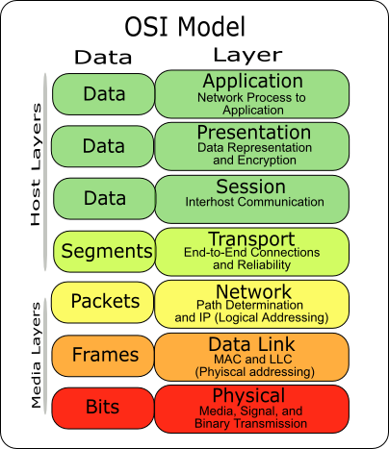
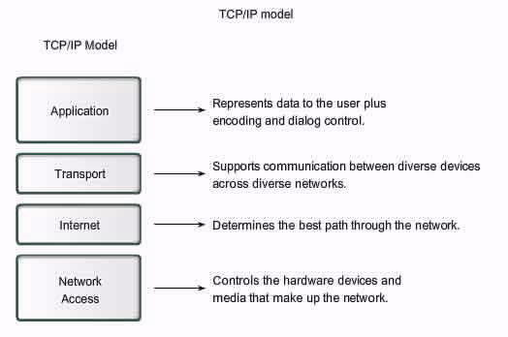
But first, OSI and TCP/IP models
The OSI and TCP/IP models

Slide 11
TCP/IP
We need to get two applications situated in remote hosts to communicate
We have a standard model that divides the communication functionality to separated abstraction layers
Each layer implementation is hidden from other layers implementation
Each layer has a protocol family which governs the way information is passed by it
We will be interested mostly in layers 3 and 4, and the data itself

Slide 12
Layer 3 (network layer)
In TCP/IP, each host has an address, which is called IP address
In IPv4 the address has the form X1 . X2 . X3 . X4:
Each of these four fields ranged from 0 to 255 (1 byte)
When a host tries to connect to remote host, he sands its address as an information for the destination and the gateways on the way
A router, or gateway, forwards traffic from one network to another
It use its routing table to know where the destination host is
If he doesn’t know – he moves it to the default gateway

Slide 13
Layer 4 (Transport layer)
On each host there is an application. Both applications need to pass data between them.
Need to make sure the data gets to the applications in the order it was send
Needs to make sure the data gets to the correct destination.
We have a TCP protocol family to make sure it happens.
For every chunk of data received the sending host needs to be informed
To start sending data, there got to be a connection
When no more data needs to be send the connection must be closed

Slide 14
Layer 4 (Transport layer) – establishing a connection
To initiate a TCP connection, we have a 3-way handshake:
SYN + seq(X)
“Hello, I’m here. I chose X.”
SYN + seq(Y) + ACK + ack(X+1)
“I heard your X. here’s your X+1. I’m here too, I chose Y.”
ACK + ack(Y+1)
“I heard your Y, here’s your Y+1.”
Now a connection has been established

Slide 15
Layer 4 (Transport layer) – passing data
Now that we have a connection we can start sending data
On each host every application has a port number
When a packet arrives to the host it moves the data to the process that is associated with that port
Server usually have a publicly known port numbers
HTTP:80
HTTPS:443
SSH:22
Clients usually have higher numbers that changes between every TCP connection

Slide 16
Layer 4 (Transport layer) – passing data (continues)
Each side sends data to the other side
The data is chunked over segments
The side that sends the packets wait for a conformation
After it receives ACK it continues to send data
In any case of data getting lost, we can ask for retransmission

Slide 17
Layer 4 (Transport layer) – terminating a connection
To terminate a connection:
FIN (client)
“I want to end this conversation”
ACK + FIN(server)
“ok, just let me finish…I’m done”
ACK (client)
“bye bye”

Slide 18
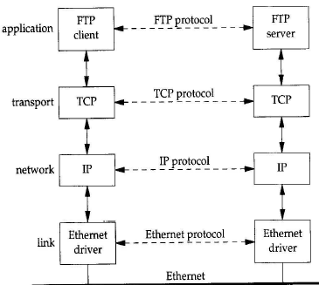
A packet’s journey
The tcp/ip stack
Logical transfer
physical transfer

Slide 19
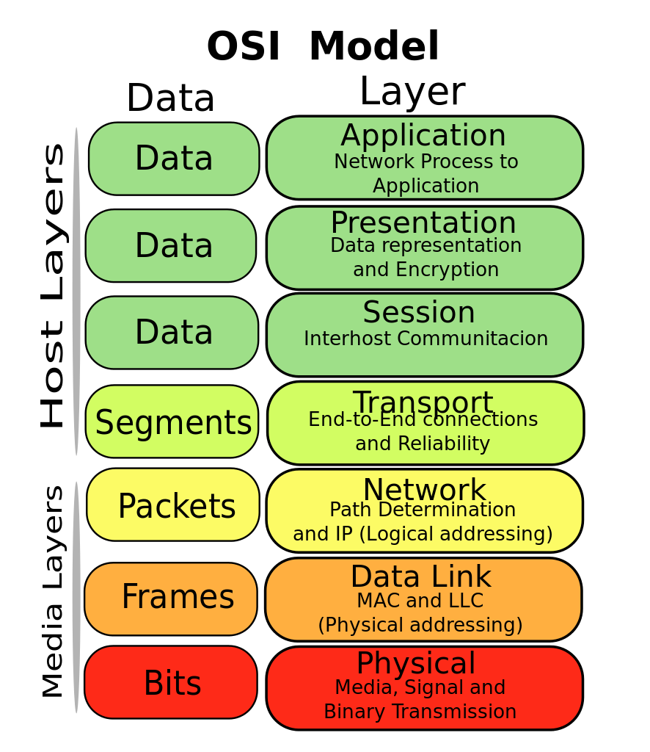
Stateless packet filtering
Works on the transport and network layers
Works by a static rule table
Each packet is individual
Each packet that is inspected waits for a verdict - accept or drop
Checks only the interesting header fields and compare them with the rules, doesn't look in the packet’s data

Slide 20
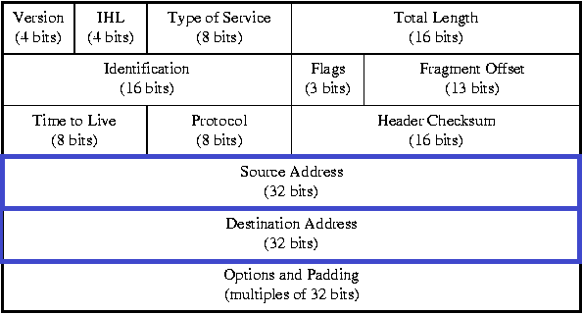
IP header (network layer)
We need to see the source and destination IP addresses to determine if accept or deny the packet

Slide 21
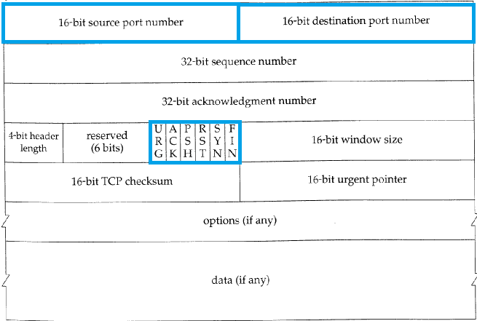
TCP header (transport layer)
We want to know the source and destination ports, and the SYN/ACK flags to determine if accept or deny the packet

Slide 22
Stateless packet filtering
Rule for example
We’re not allowing incoming network designated to port 80
Direction | Src address | Dst address | Protocol | Src port | Dst port | Syn/Ack | Action
In | Any | Network | any | any | 80 | Any | deny

Slide 23
Stateless inspection
Pros
Low performance impact
Easy to configure
Cons
Relies on static header fields, therefore easy to spoof and manipulate
Doesn’t look in the data itself
Transparent to the client

Slide 24
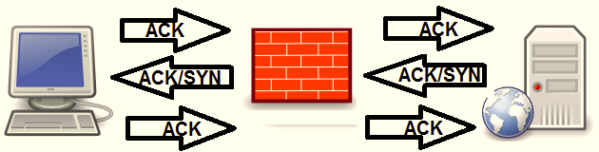
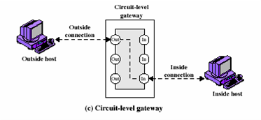
Circuit-level Gateway
Works on the session layer
Monitor TCP handshake between packets to determine if the session request is legitimate. Saves connections in dynamic connection tables
Create 2 TCP connection, functions as MITM

Slide 25
Circuit-level Gateway
Pros
Low performance impact
conceal the network itself from the external computer
Cons
Doesn’t filter individual packets, after legitimate session opening doesn’t check what’s coming
Transparent to the client
Handle only TCP connections

Slide 26
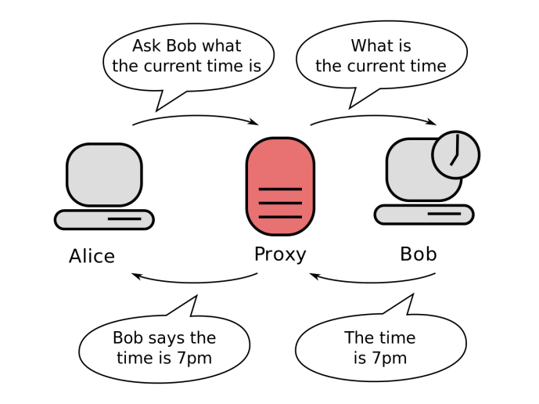
Application-level/proxy gateway
Works on the application layer
Sits in the middle of the service and operate as a server (to the client) and as a client (to the server)
Hence – a proxy server, filter and examine individual packets streams, depends on the service/application
[Restricted] ONLY for designated groups and individuals

Slide 27
Application-level/proxy gateway
Pros
Inner hosts IP hiding
Header destruction
Cons
High performance impact (data based filter, not only specific fields from headers)
Protocol enforcement
logging
Not transparent to the client
Only supported protocols can be used

Slide 28
Stateful inspection
Combination of all older methods
Decide what to do with a packet based on:
Dynamic connection tables
Old connections
Information from the application layer
Inspect the headers and the data
[Restricted] ONLY for designated groups and individuals

Slide 29
Stateful inspection
Pros
Good security coverage, deals with all levels and able to provide high level of defense
Cons
Complicated and can hurt security and experience if not managed properly
No proxies – transparent to the client
Most expansive method (requires most resources)

Slide 30
Types of Firewall
1
What is Firewall
2
Types of Firewall
3
Firewall in Linux kernel
Notes:
30
30
30

Slide 31
Packet inspection in Linux kernel
As we discus, the firewall should have minimum performance impact. Therefore we need to implement it in the kernel, so it would have access to Linux network structures to be able to see the packets.
Linux use structure for each protocol and layer
We will be interested in the internet and transport layer (and of course the data itself)
IP header
TCP/UDP header
Data
HTTP/1.1 200 OK0x20Last-Modified: Mon, 07 Apr 2014 09:16:25
GMT0x20Content-Type: image/jpeg0x20Cache-Control:
max-age = 3153600000x20magicmarker: 10x20Content-Length:
47060x20Accept-Ranges: bytes0x20Date: Mon, 07 Apr 2014
11:35:46 GMT0x20X-Varnish: 2786274250 27578957660x20Age:

Slide 32
Lecture 1.2: Linux and Networking

Slide 33
Agenda
1
Virtualization
2
Linux kernel modules and networking
3
Netfilter
4
About first Assignment
Notes:
33
33
33

Slide 34
Virtualization
1
Virtualization
2
Linux kernel modules and networking
3
Netfilter
4
About first Assignment
Notes:
34
34
34

Slide 35
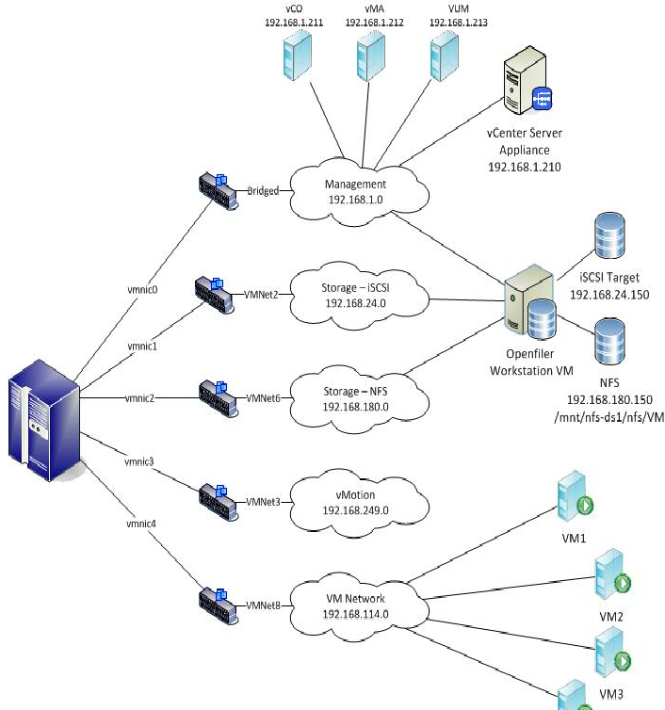
Virtual network
Virtual Machine software, like VMware or VirtualBox, provide a service which allow us to build not only virtual computers, but virtual networks too.

Slide 36



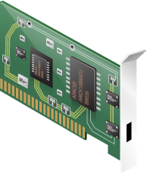
The Virtual NIC
Although we only have one NIC, we can
simulate multiple NICs
vNICs send and receive data through
the physical NIC
Data is written to register-variables, sent to the
physical registers
When an answer arrived the NIC interrupts,
the virtualization layer inject the interrupt into the vNIC
Virtualization layer

Slide 37
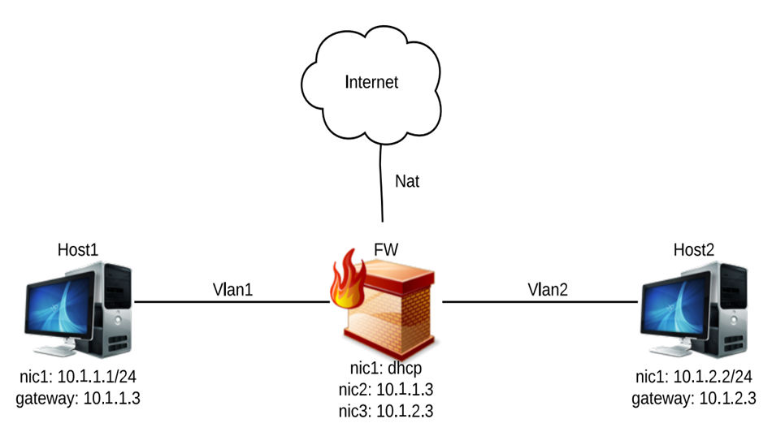
Virtual Network in our Workshop
in
out

Slide 38
The VMs
There are three virtual machines we will work with:
FW: this is the firewall machine, which will sit in the middle of the topology. It runs Ubuntu with GUI, so you can do development inside the VM
in
out

Slide 39
The VMs
There are three virtual machines in the course site:
2-3. host1 and host2: testing machines which will communicate with each other though your firewall. Runs Ubuntu cli
in
out

Slide 40
Linux kernel modules and networking
1
Virtualization
2
Linux kernel modules and networking
3
Netfilter
4
About first Assignment
Notes:
40
40
40

Slide 41
What is a Kernel Module
An object file that contains code to extend the operating system’s kernel
Loaded at run time, after kernel is already up and running
Adds functionality:
Device drivers
New features

Slide 42
How kernel modules different from user-space programs
Cannot use regular libraries, like stdlib
Most of C library is implemented in the kernel
Besides, <kernel.h> offers some nice utilities
Cannot use floating point math
Run in privileged mode, so security is critical
Don’t trust the user
Check all input sizes, formats, etc.
Check all exceptional conditions and potential errors
Don’t trust the user
More about it - Linux Kernel Development, pages 16-22

Slide 43
Building the Module
The purpose – eliminate the need to re-compile the kernel every time you need to add/remove a specific feature
A Makefile that adapts itself to current kernel
Put the module in and out the kernel by command line
insmod <module name> to insert the module
rmmod <module name> to remove it
Initialization function that is called when the module enters the kernel
Cleanup function that is called when the module is removed from the kernel

Slide 44
Simple kernel module
#include <linux/module.h> /* Needed by all modules */
#include <linux/kernel.h> /* Needed for KERN_INFO */
int init_module(void) {
printk(KERN_INFO "Hello World!\n");
return 0; /* if non-0 return means init_module failed */
}
void cleanup_module(void) {
printk(KERN_INFO "Goodbye World!\n");
}

Slide 45
Explanation
init_module() is called when module is loaded
cleanup_module() is called when module is unloaded
Another option: Macros!

Slide 46
Simple module with macros
#include <linux/module.h> /* Needed by all modules */
#include <linux/kernel.h> /* Needed for KERN_INFO and for the Macros */
static int __init my_module_init_function(void) {
printk(KERN_INFO "Hello World!\n");
return 0; /* if non-0 return means init_module failed */
}
static void __exit my_module_exit_function(void) {
printk(KERN_INFO "Goodbye World!\n");
}
module_init(my_module_init_function);
module_exit(my_module_exit_function);

Slide 47
What are Macros and why
__init and __exit macros tells the kernel when we use those functions
This allows to free kernel memory that is used only at init
Kernel memory is scarce, and we need to free it whenever we can

Slide 48
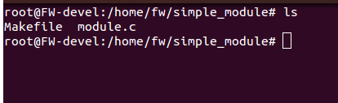
How to compile a Linux module?
Suppose that our simple module called “module.c”
We need in this folder another file called “Makefile” (case sensitive)
This file contains instructions to the OS how to compile this module

Slide 49
Simple Makefile
obj-m += module.o
all:
make -C /lib/modules/$(shell uname -r)/build M=$(PWD) modules
clean:
make -C /lib/modules/$(shell uname -r)/build M=$(PWD) clean

Slide 50
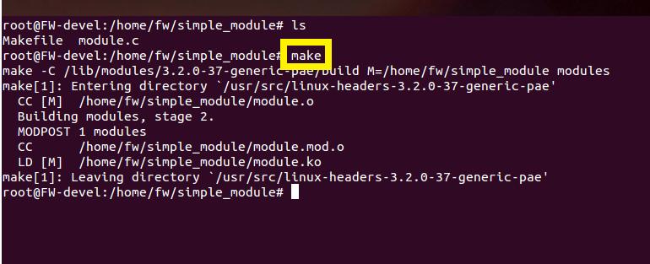
How to compile a Linux module?
Then, the command “make” compiles the module
The file “module.ko” is the executable file

Slide 51
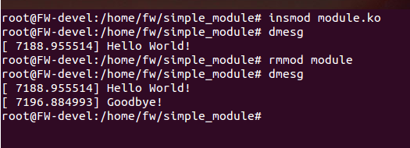
How to load a Linux module?
The command “insmod <mod_name>.ko” binds the module to the kernel. The “init” function is being execute
The command “rmmod <mod_name>” removes the module from the kernel. The “cleanup” function is being execute

Slide 52
Our Kernel Module – The Firewall!
What will we do with our kernel module? (spoilers ahead)
Register our own functions (AKA: hooks) with the netfilter API, to issue verdicts on packets going in/out/through our Linux box
Register a char device, to communicate with the user space
Send commands to set module values
Receive data from the firewall about the state of the system
When our module will be removed, it will clean up all this mess, as if it was never there

Slide 53
Linux networking
We need a way to see the packets
Packets has headers for each layer and data
Linux contains set of useful tools and structures to manage packets over the kernel

Slide 54
Packet Headers
Each packet comes with headers, each for every layer
The layers we are interested in are the network layer and transport layer
IP header
TCP/UDP header
Data
HTTP/1.1 200 OK0x20Last-Modified: Mon, 07 Apr 2014 09:16:25
GMT0x20Content-Type: image/jpeg0x20Cache-Control:
max-age = 3153600000x20magicmarker: 10x20Content-Length:
47060x20Accept-Ranges: bytes0x20Date: Mon, 07 Apr 2014
11:35:46 GMT0x20X-Varnish: 2786274250 27578957660x20Age:
83980x20Via: 1.1 varnish0x20Connection: keep-alive0x20X-Cache:

Slide 55
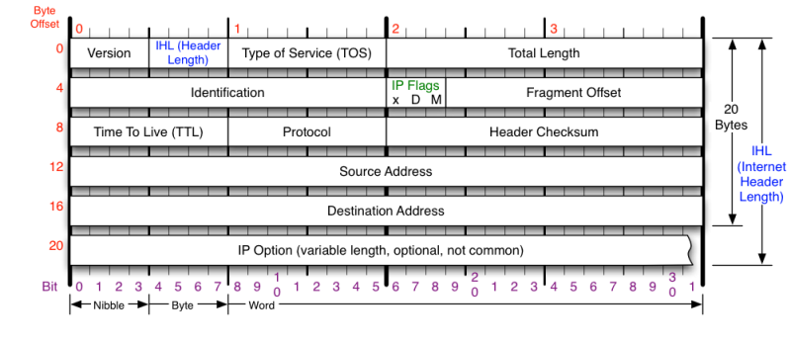
IP Header

Slide 56
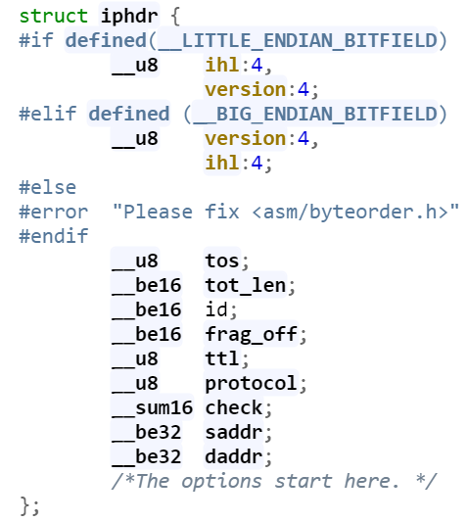
IP Header, how Linux knows it
Declared in linux/ip.h
To be on the safe side, don’t forget to use htonl, htons, ntohl, ntohs when processing the fields

Slide 57
Packet Headers
Each packet comes with headers, each for every layer.
The layers we are interested in are the network layer and transport layer
IP header
TCP/UDP header
Data
HTTP/1.1 200 OK0x20Last-Modified: Mon, 07 Apr 2014 09:16:25
GMT0x20Content-Type: image/jpeg0x20Cache-Control:
max-age = 3153600000x20magicmarker: 10x20Content-Length:
47060x20Accept-Ranges: bytes0x20Date: Mon, 07 Apr 2014
11:35:46 GMT0x20X-Varnish: 2786274250 27578957660x20Age:
83980x20Via: 1.1 varnish0x20Connection: keep-alive0x20X-Cache:

Slide 58
Packet Headers
Each packet comes with headers, each for every layer.
The layers we are interested in are the network layer and transport layer
IP header
TCP/UDP header
Data
HTTP/1.1 200 OK0x20Last-Modified: Mon, 07 Apr 2014 09:16:25
GMT0x20Content-Type: image/jpeg0x20Cache-Control:
max-age = 3153600000x20magicmarker: 10x20Content-Length:
47060x20Accept-Ranges: bytes0x20Date: Mon, 07 Apr 2014
11:35:46 GMT0x20X-Varnish: 2786274250 27578957660x20Age:
83980x20Via: 1.1 varnish0x20Connection: keep-alive0x20X-Cache:

Slide 59
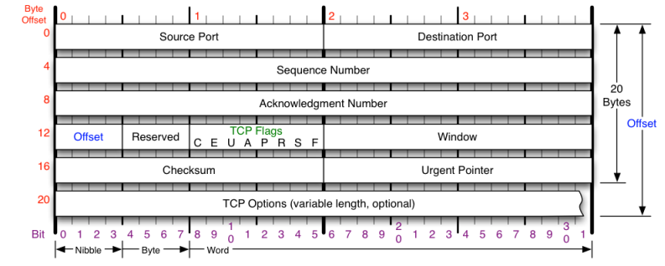
TCP Header

Slide 60
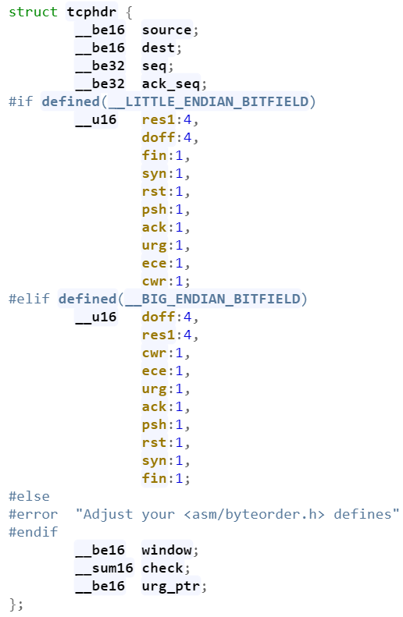
TCP Header, how Linux knows it
Defined in linux/tcp.h

Slide 61
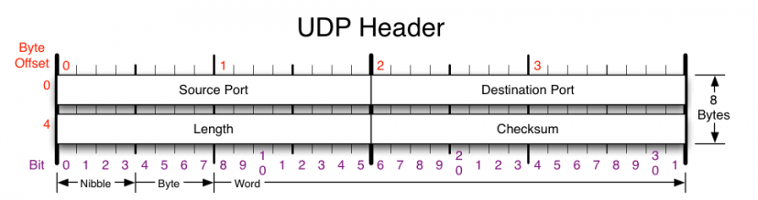
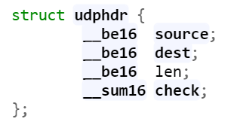
UDP Header
Defined in linux/udp.h

Slide 62
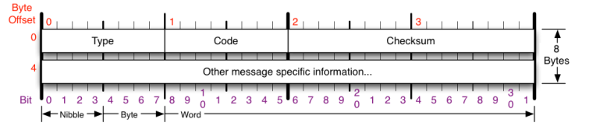
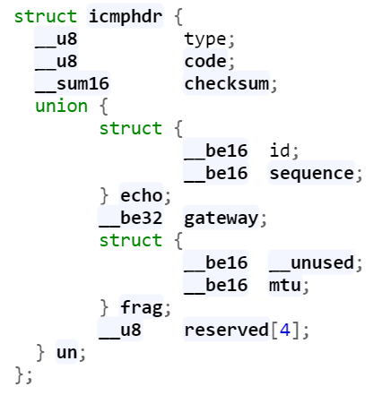
ICMP Header
Defined in linux/icmp.h

Slide 63
sk_buff
The Linux struct that holds a pointer to the packet and metadata about the packet
Hold many fields for many purposes
head, data, tail , end
transport layer headers
tcphdr, udphdr, icmphdr
network layer headers
iph, ipv6h
The packet is copied directly to the RAM (DMA) and each part of the kernel that touches it, just gets a pointer
IP header:
TCP/UDP header
Data
HTTP/1.1 200 OK0x20Last-Modified: Mon, 07 Apr 2014 09:16:25
GMT0x20Content-Type: image/jpeg0x20Cache-Control:
max-age = 3153600000x20magicmarker: 10x20Content-Length:
47060x20Accept-Ranges: bytes0x20Date: Mon, 07 Apr 2014
11:35:46 GMT0x20X-Varnish: 2786274250 27578957660x20Age:
83980x20Via: 1.1 varnish0x20Connection: keep-alive0x20X-Cache:

Slide 64
Agenda
1
Virtualization
2
Linux kernel modules and networking
3
Netfilter
4
About first Assignment
Notes:
64
64
64

Slide 65
Netfilter
Easy API to handle and examine packets from the internet
#include <linux/netfilter.h>
#include <linux/netfilter_ipv4.h>
Allow us to hook functions to the packet’s route on a specific (important) points though the kernel
There are 5 inspection points we can hook into, each for a different type of packets

Slide 66
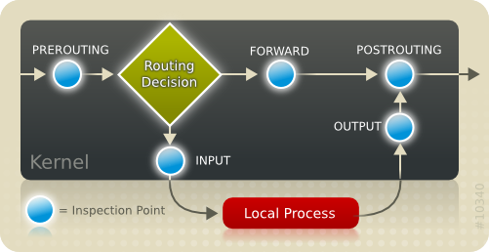
Netfilter hook points
Where packets come in, having passed the simple sanity checks they are passed to the netfilter framework's NF_IP_PRE_ROUTING hook

Slide 67
Netfilter hook points
The routing code decides whether the packet is destined for another interface or a local process. If it's destined for the box itself, the netfilter framework is called again for the NF_IP_LOCAL_IN hook, before being passed to the process

Slide 68
Netfilter hook points
If it's destined to pass to another interface instead, the netfilter framework is called for the NF_IP_FORWARD hook

Slide 69
Netfilter hook points
The packet then passes a final netfilter hook, the NF_IP_POST_ROUTING hook, before the packet reaches the wire again.

Slide 70
Netfilter hook points
The NF_IP_LOCAL_OUT hook is called for packets that are created locally.
Routing code is called before this hook to figure out the IP address and after this hook to decide the route.

Slide 71
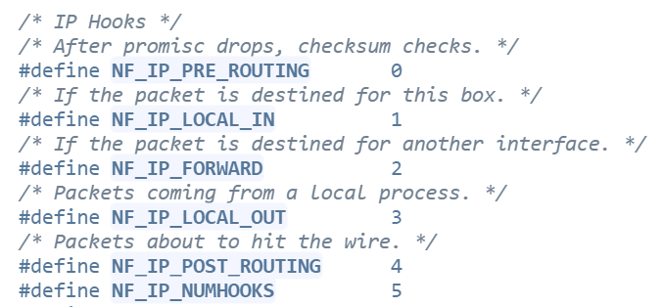
Netfilter hook points
You can find it in the source code: https://elixir.bootlin.com/linux/v4.15/source/include/uapi/linux/netfilter_ipv4.h#L44

Slide 72
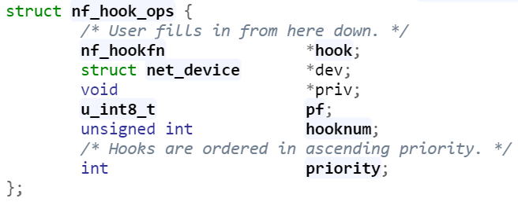

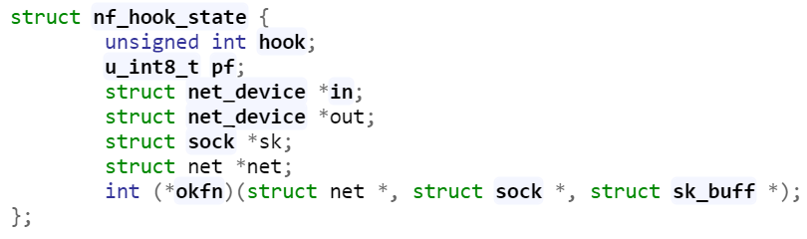
The hook

Slide 73
Agenda
1
Virtualization
2
Linux kernel modules and networking
3
Netfilter
4
About first Assignment
Notes:
73
73
73

Slide 74
Assignment 1 – Building the virtual lab
In this assignment we will create the virtual lab
Use VirtualBox or VMware workstation.
Don’t use VMware player, it doesn’t support virtual networks
Pay attention for network configuration (make it persistent)
In the course site you’ll have 3 VMs (for VirtualBox): client, server and FW, so wont have to lose time installing Ubuntu machines. Most of the heavy coding will be performed on the FW VM

Slide 75
Assignment 1
Make sure you don’t have kernel panics when you load the module – this would have heavy penalty on your grade
In this assignment, you decide the verdict for each packet base on it’s type, not content. Make use of that fact to make it easier on you. That said, you can use whatever method you want

